Slide 1
THE ‘BRIDGE’ DESIGN PATTERN
Daniel Cuevas
CS 445 – Spring 2015

Slide 2
WHAT IS THE ‘BRIDGE’ DESIGN PATTERN?
A structural design pattern meant to simplify the relationships between identities.
Decouple an abstraction from its implementation, allowing the two to vary independently.
Both the abstraction and the implementation develop separate inheritance structures.
The abstraction can be either an abstract or interface class.
The implementer is also either an abstract or interface class.

Slide 3
THE ABSTRACTION
The abstraction contains a reference to the implementer.
Children of an abstraction are referred to as refined abstractions.
Possible to change the reference to the implementer during run-time.
Can be thought of as the device being controlled by the implementer.
The implementer would affect the abstraction through the ‘bridge’ that is created via the abstraction

Slide 4
THE IMPLEMENTER
Children of the implementer are referred to as concrete implementers.
Changes can be done to the implementer classes during run-time.
Changes do not affect the client (abstractions).
Controls the actions that would affect the abstraction.
Can be thought of as a remote to the TV
Multiple different remotes with different functionality for multiple TVs

Slide 5
WHEN TO USE THE DESIGN PATTERN?
When you need to change the device and the controller independently by decoupling them.
The device being the abstraction and the controller being the implementer.
When you want to add functionality without affecting the client (device) code.
If there’s different user interfaces in different systems that do different functionality on a similar client (device)

Slide 6
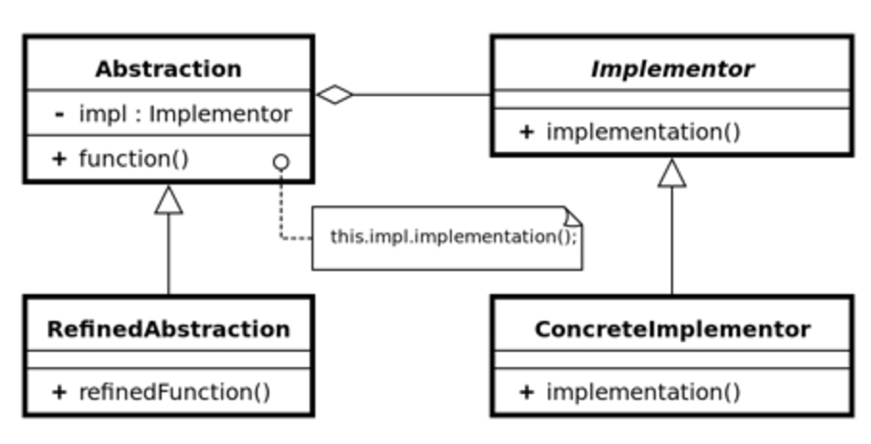
BASIC EXAMPLE:

Slide 7
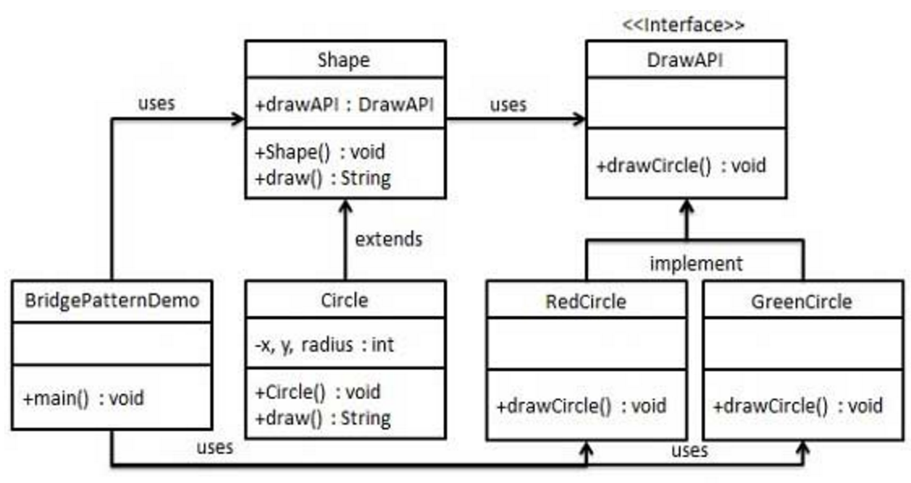
A SIMPLE EXAMPLE:
REFINED ABSTRACTIONS
CONCRETE IMPLEMENTERS
Notes:
The DrawAPI is the interface (implementer) of the application. The Shape is the abstraction. Both of these classes can have multiple children, then the refined abstractions can use any of the concrete implementers.

Slide 8
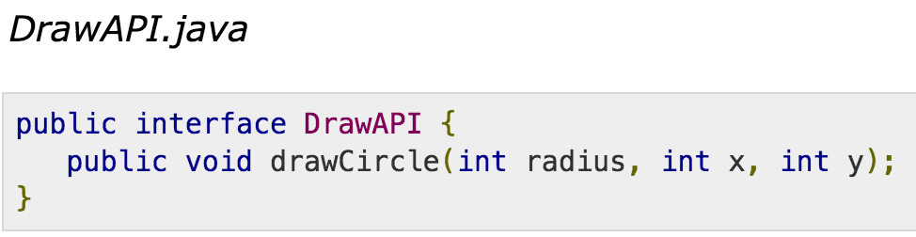
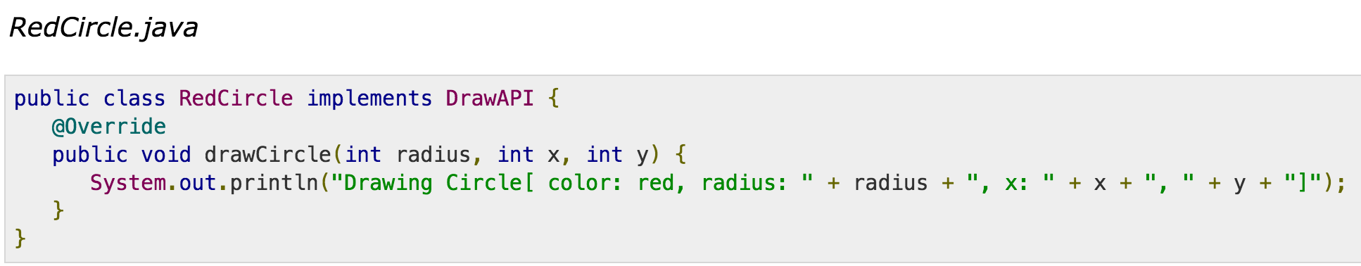
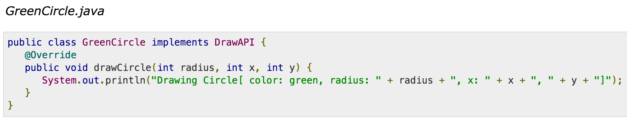
THE IMPLEMENTERS.
IMPLEMENTS

Slide 9
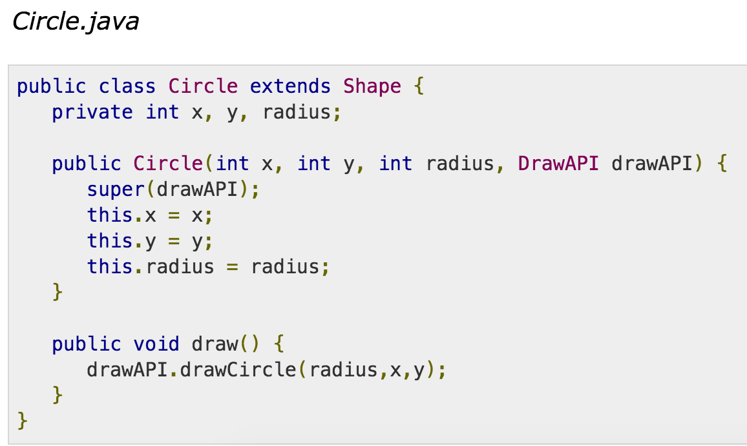
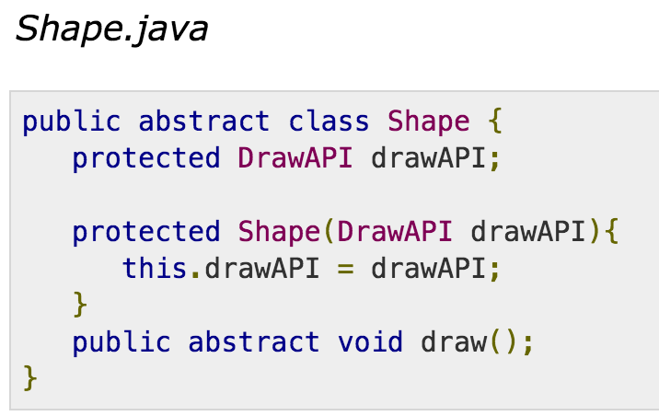
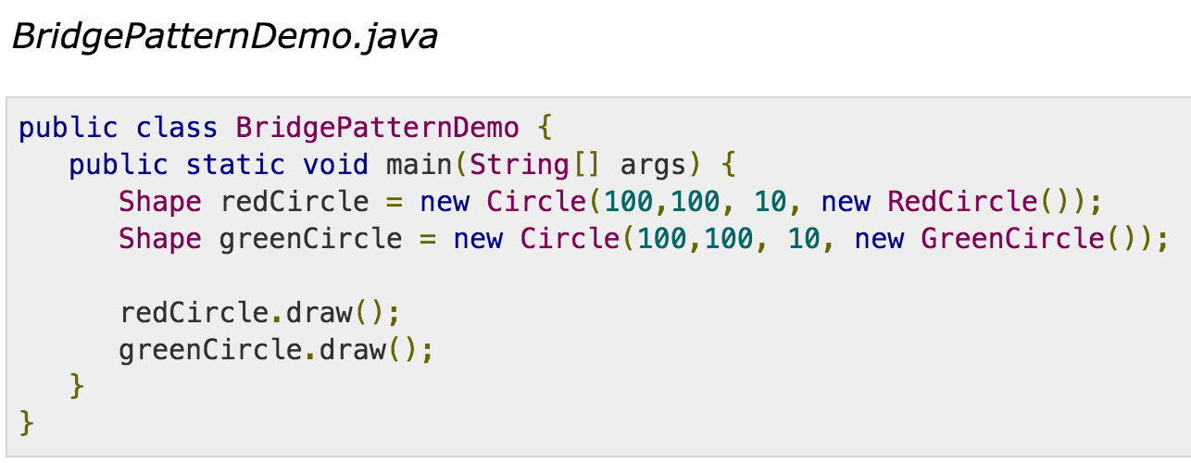
THE ABSTRACTIONS
EXTENDS
USES

Slide 10
RESOURCES:
http://www.avajava.com/tutorials/lessons/bridge-pattern.html
http://simpleprogrammer.com/2015/06/08/design-patterns-simplified-the-bridge-pattern/
https://sourcemaking.com/design_patterns/bridge
http://www.oodesign.com/bridge-pattern.html
http://programmers.stackexchange.com/questions/121326/understanding-the-bridge-design-pattern
https://www.youtube.com/watch?v=9jIgSsIfh_8

